Slide 1
CSE 3100: Systems Programming
Lecture 6 : Memory Allocation
Department of Computer Science and Engineering
University of Connecticut

Slide 2
1. Memory Organization and Malloc
Memory Allocation Lecture Topics
2. Tracking Array Size
3. More on Arrays and Multi-dimensional Arrays

Slide 3
Recall: Memory Organization (1)
Three pools of memory
  Static/global
  Stack
  Heap
Each pool features
  Different lifetime
  Different allocation/deallocation policy
0xffffffff
0x00000000

Slide 4
Recall: Memory Organization (2)
Memory….
  Every Process has an
    Address Space
  Executable code is at the bottom
  Statics and globals are just above
  Stack is at the top (going down!)
  Heap grows from the bottom (going up!)
  Gray no-man’s land is up for grab
  Low end may not start from 0.
  High end may not be the 0xff…ff.
0xffffffff
High
Low
0x00000000

Slide 5
Static/global memory pool
This is where
  All constants (including string literals) are held
  Global variables
  All variables declared “static” are held
Allocated when:
  The program starts
Deallocated when:
  The program terminates
FIXED SIZE
  Compiler needs to know the size and make reservations

Slide 6
Stack
This is where….
  Memory comes from, for local variables in functions.
Easy to manage because it is automatic!
  Allocated automatically when entering the function
  De-allocated automatically when you leave the function
    Scope is that of function
    Should not be used after the function returns
      For example, indirectly used via a pointer
Default stack size using gcc is 2 MB (Megabytes).
May need to increase stack size for large arrays and deep recursion

Slide 7
Heap
This is where…
  Memory comes from for manual “on-the-fly” allocations
Who is in charge ?
  The programmer for both allocation / deallocation
Lifetime of memory blocks ?
  As long as they are not freed!

Slide 8

Manipulating Memory in C
In the previous lecture we asked a very basic question:
In C how do I get my functions to return multiple values (arrays)?

Slide 9
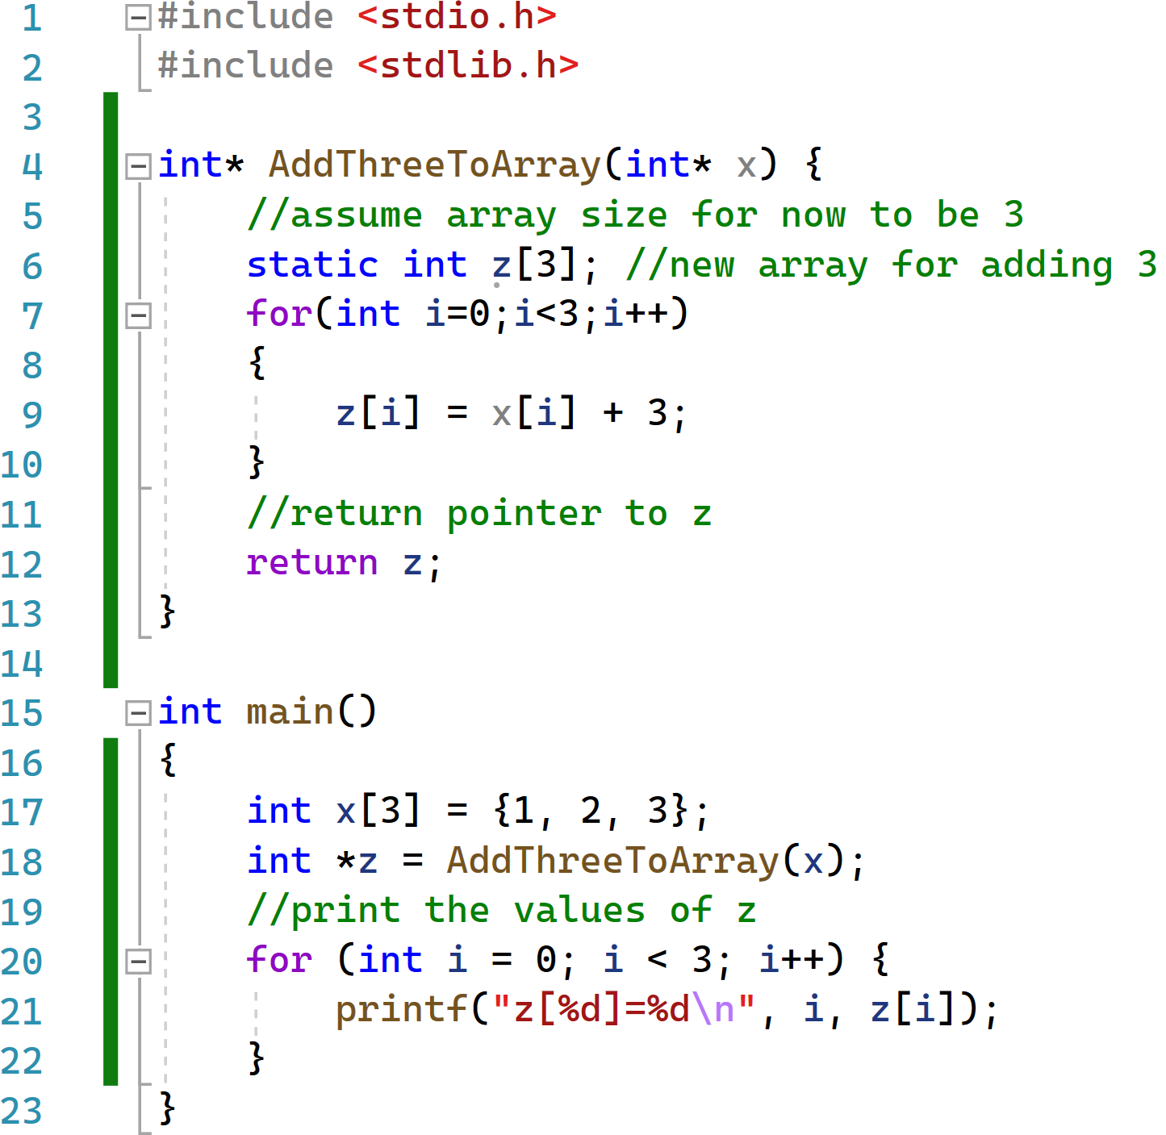
(Bad) Solution 1: Use Static Memory
Are there any problems with this approach?
If we want to call the function multiple times, old solution will be over written.
The static memory is allocated WHEN the program starts and is fixed. What if we don’t know the size of the solution before run time?

Slide 10
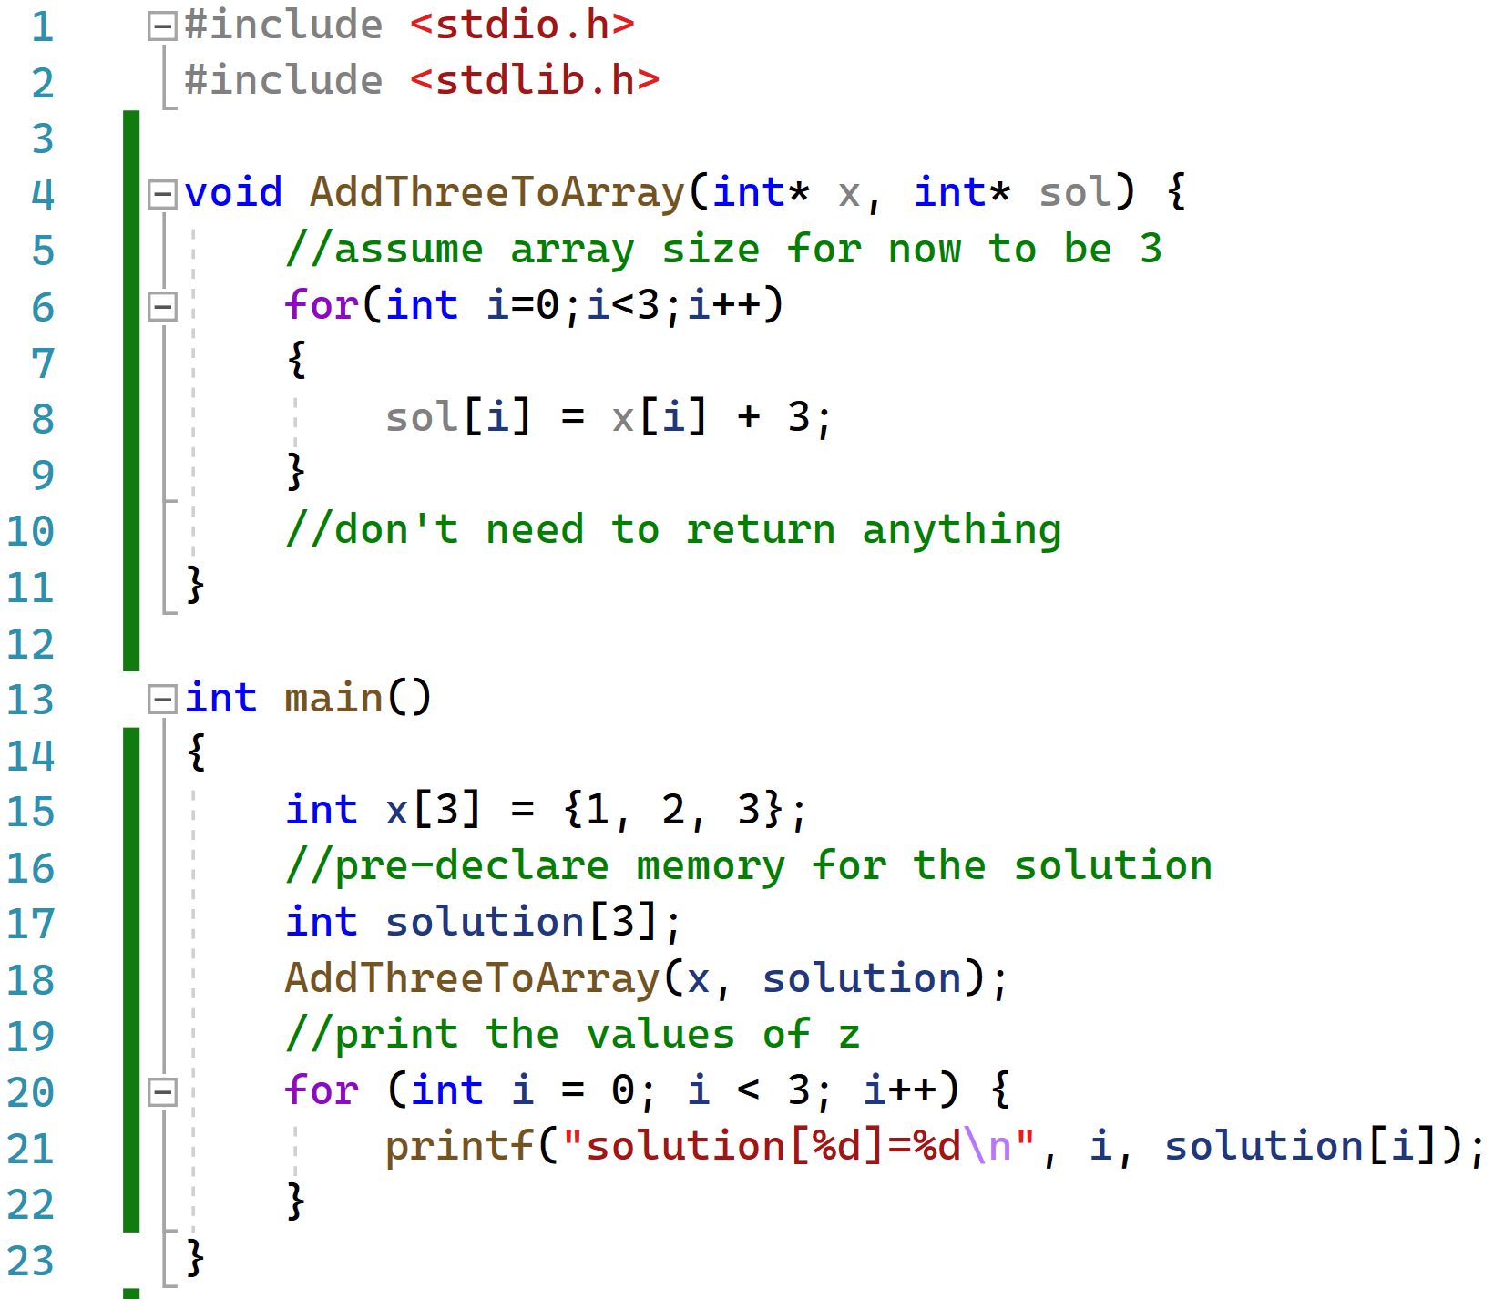
(Bad) Solution 2: Pass the empty solution as input
Are there any problems with this approach?
What if we don’t know the size of the solution BEFORE the method is called?
Clearly we need a way to allocate memory during run time.

Slide 11
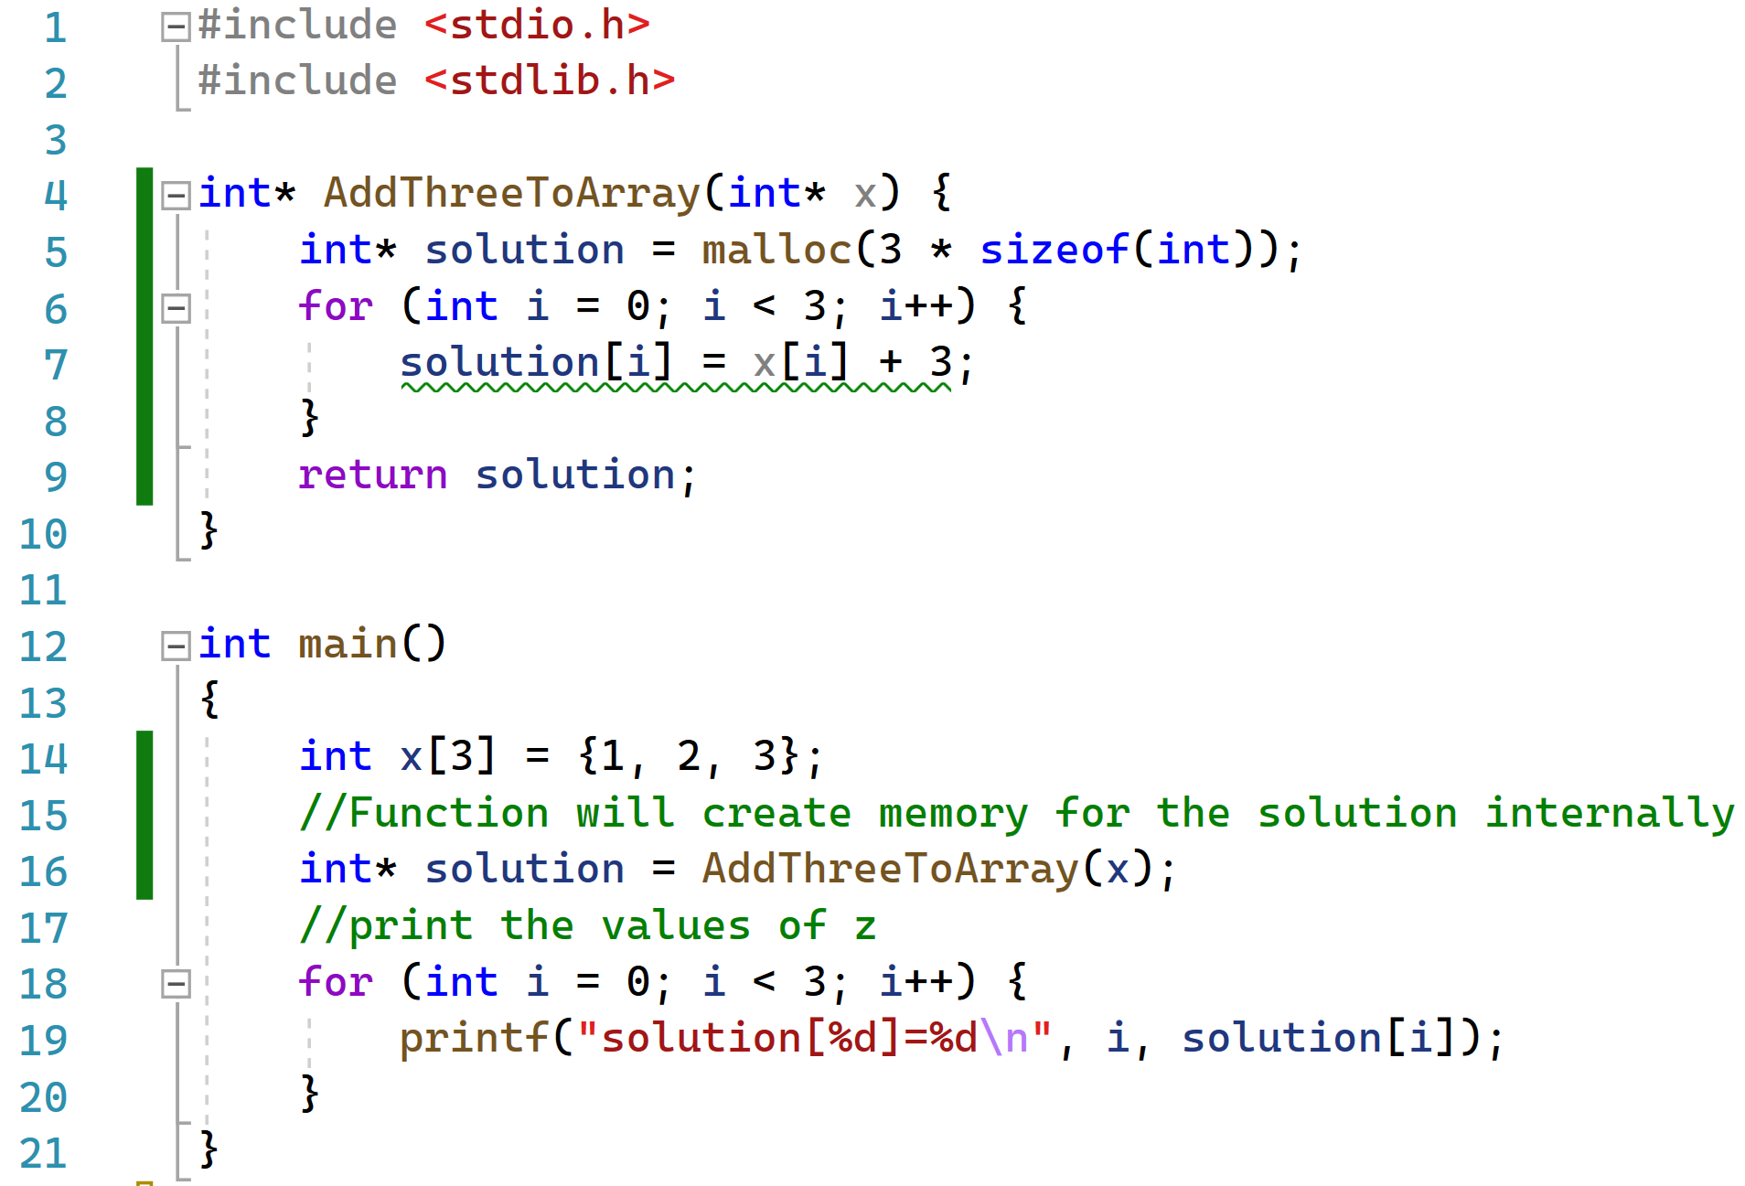
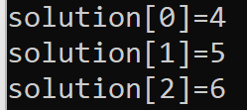
Good Solution: Allocate Memory Dynamically

Slide 12
Malloc: Requesting Memory on the Heap
#include <stdlib.h>
void* malloc(size_t size);
  size_t is an unsigned integer data type defined in <stdlib.h>
  used to represent sizes of objects in bytes
If successful, a call to malloc(n) returns a generic pointer (void *)
  It points to a memory block of n bytes on the heap
If not successful, NULL is returned

Slide 13
Generic pointers: void*
Pointer to a memory block whose content is “un-typed”
Use for raw memory operations or in generic functions
Automatic casting when assigned to other pointer types
  int * pox = malloc(6 * sizeof(int));
Requires casting before dereferencing for read / write
*(int *)pv; // use pv as an int *
NULL, a special pointer value useful for initializations, error handling
  #define NULL ((void*)0)

Slide 14

The Rolling Stones once famously sang:
“You can’t always get what you want.”
What where they singing about?
About the disappointments in life (unlikely)
About a call to malloc failing because you don’t have enough computer memory.

Slide 15
You Can’t Always Get What You Want
A call to malloc() may fail
  For example, if you are out of memory
In this case you get back a NULL value
  Not much to do except report the error (and terminate nicely)
char* p = malloc(100); // request 100 bytes
if (p == NULL) {
// report error and finish
perror("Not enough memory");
exit(1);
}

Slide 16
1. Memory Organization and Malloc
Memory Allocation Lecture Topics
2. Tracking Array Size
3. More on Arrays and Multi-dimensional Arrays

Slide 17

Any lingering issues with our code?
We still have hard coded variables!

Slide 18
We can further break this problem down into two cases:
We are working with an array that has a pre-declared size:
int x[3] = {1, 2, 3};
2. We are working with an array created using malloc:
int* solution = malloc(3 * sizeof(int));

Slide 19
Case 1: Counting Elements in Pre-Declared Arrays
When passed an array not declared using malloc, how do we know its size?
We need to know what type of data the array holds.
If we know the type of data we can divide the total size of the array by the size of one element of data. That gives us the number of elements in the array.
$$Number of elements in Array=\frac{Size of the Array (in bytes)}{Size of 1 Array Element (in bytes)}$$

Slide 20
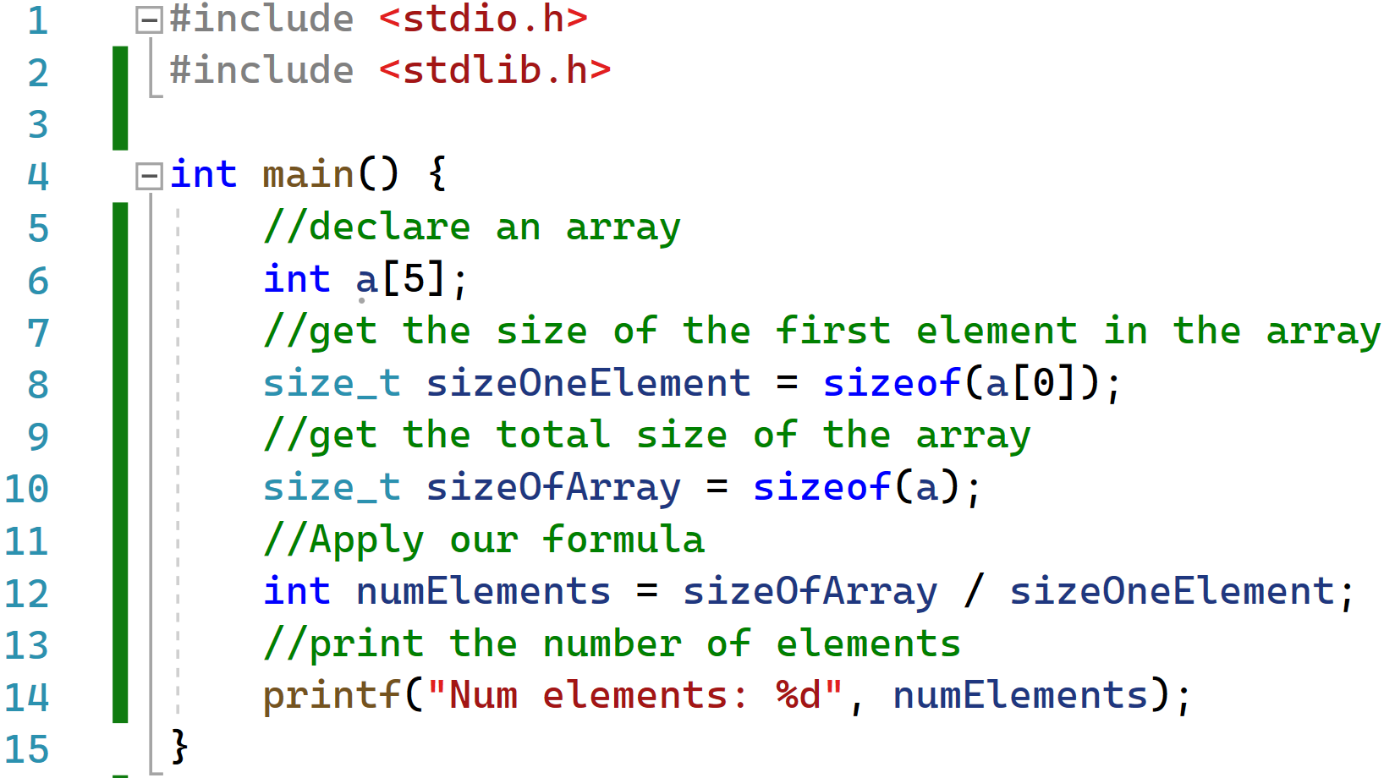

Case 1: Counting Elements in Pre-Declared Arrays
$$Number of elements in Array=\frac{Size of the Array (in bytes)}{Size of 1 Array Element (in bytes)}$$

Slide 21

Follow up Question:
$$Number of elements in Array=\frac{Size of the Array (in bytes)}{Size of 1 Array Element (in bytes)}$$
If all we need is the simple formula above why isn’t it already built into C as a function?
Most of the class right now:

Slide 22
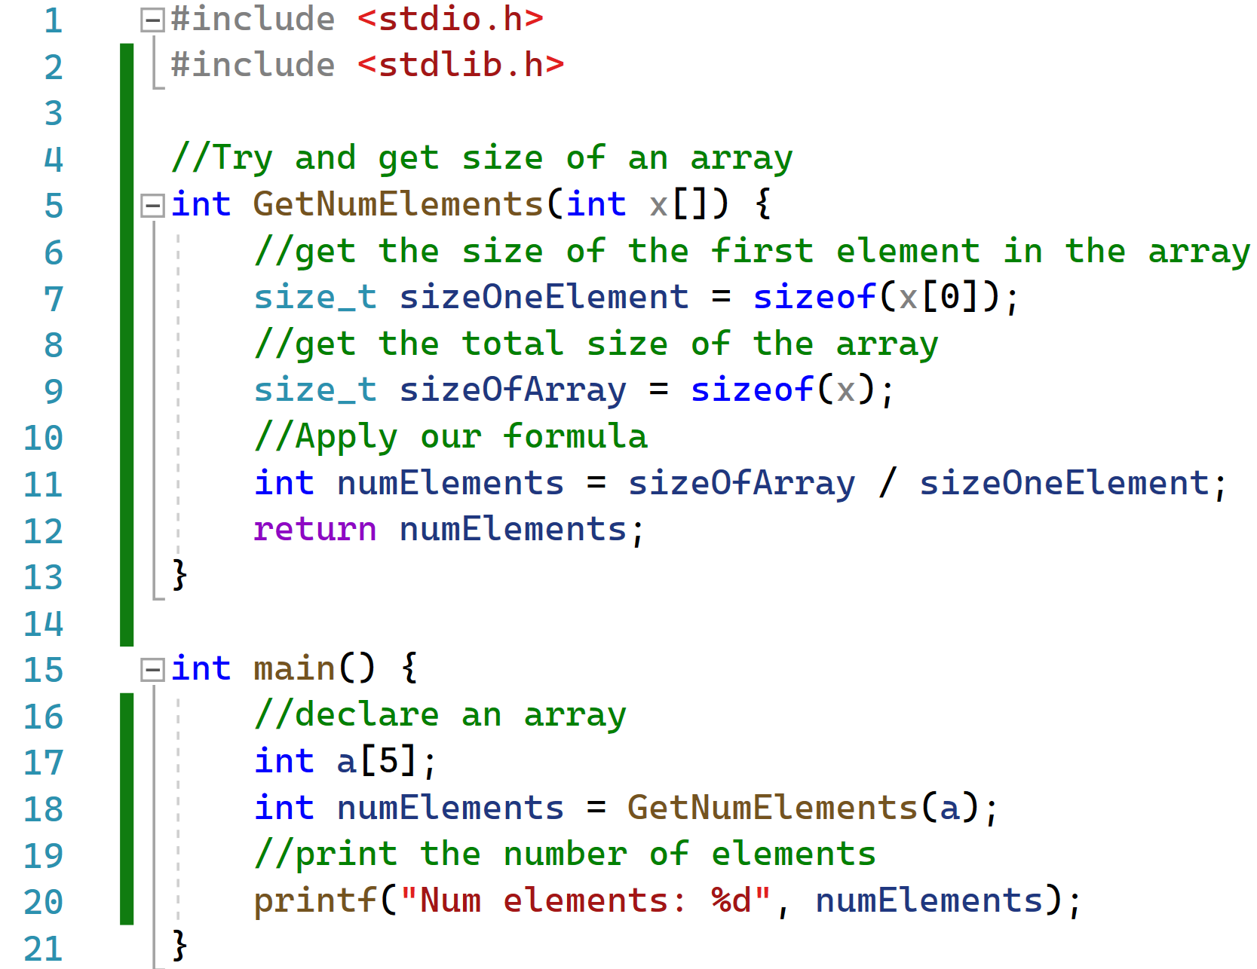


Trying to build our own function to find number of elements…

Slide 23
Explaining the Issue
In C how are arrays passed to functions?
They are passed as POINTERS.
The function doesn’t see the entire array. It only sees a pointer to the first element in the array.
When we are running code inside the function in line 5, who is x and what is its size?
x is a pointer that points to the first element of x in memory. See next slide for a picture.

Slide 24
Pictorial View of What is Going on…

Slide 25
Pictorial View of What is Going on…
a[0]
a[1]
a[2]
a[3]
a[4]
Value:
Address in Mem:
104
105
106
107
108

Slide 26
Pictorial View of What is Going on…
a[0]
a[1]
a[2]
a[3]
a[4]
Value:
Address in Mem:
104
105
106
107
108

Slide 27
Pictorial View of What is Going on…
a[0]
a[1]
a[2]
a[3]
a[4]
104
Value:
Address in Mem:
104
105
106
107
108
209
x
Remember when we call the function, our array is passed in BY reference.
This means we get a variables whose value is the first memory address of array “a”.
Do we know where “a” ends? Not when the variable is passed to us by reference.

Slide 28
Pictorial View of What is Going on…
a[0]
a[1]
a[2]
a[3]
a[4]
104
Value:
Address in Mem:
104
105
106
107
108
209
x
Skip ahead a bit to line 9. What is the size of x?
x is a pointer so the size of x is whatever the size of a pointer will be.
x is NOT the size of the array “a”.

Slide 29
Back to our original question…
When passed an array not declared using malloc, how do we know its size and how do we remove the hard coded variables?

Slide 30
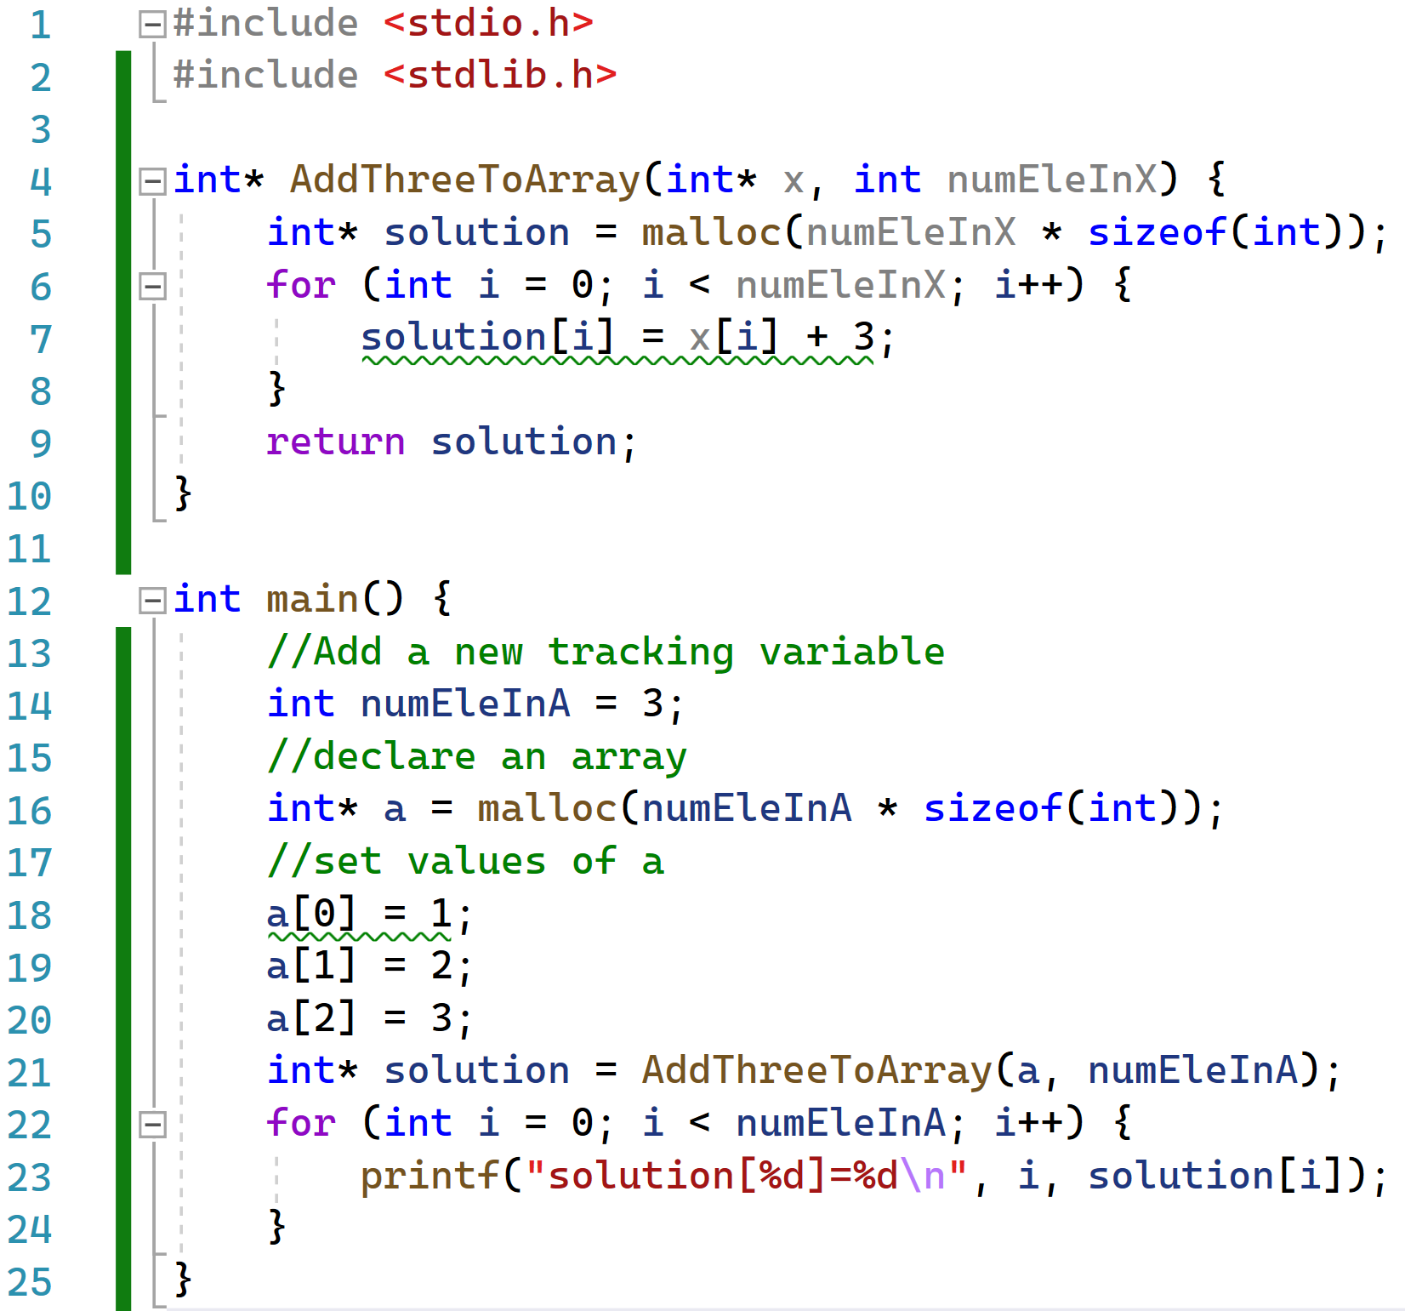

Back to our question…
When passed an array, how do we know its size and how do we remove the hard coded variables?
When you find out you have to keep track of the array size in C yourself:

Slide 31
Recall we started by trying to break the problem down into two parts:
We are working with an array that has a pre-declared size:
int x[3] = {1, 2, 3};
2. We are working with an array created using malloc:
int* solution = malloc(3 * sizeof(int));
What about for the second case?
Short Answer: Malloc creates new memory by giving you a pointer to a memory address. You need to keep track, no function can double check for you later.

Slide 32
1. Memory Organization and Malloc
Memory Allocation Lecture Topics
2. Tracking Array Size
3. More on Arrays and Multi-dimensional Arrays

Slide 33
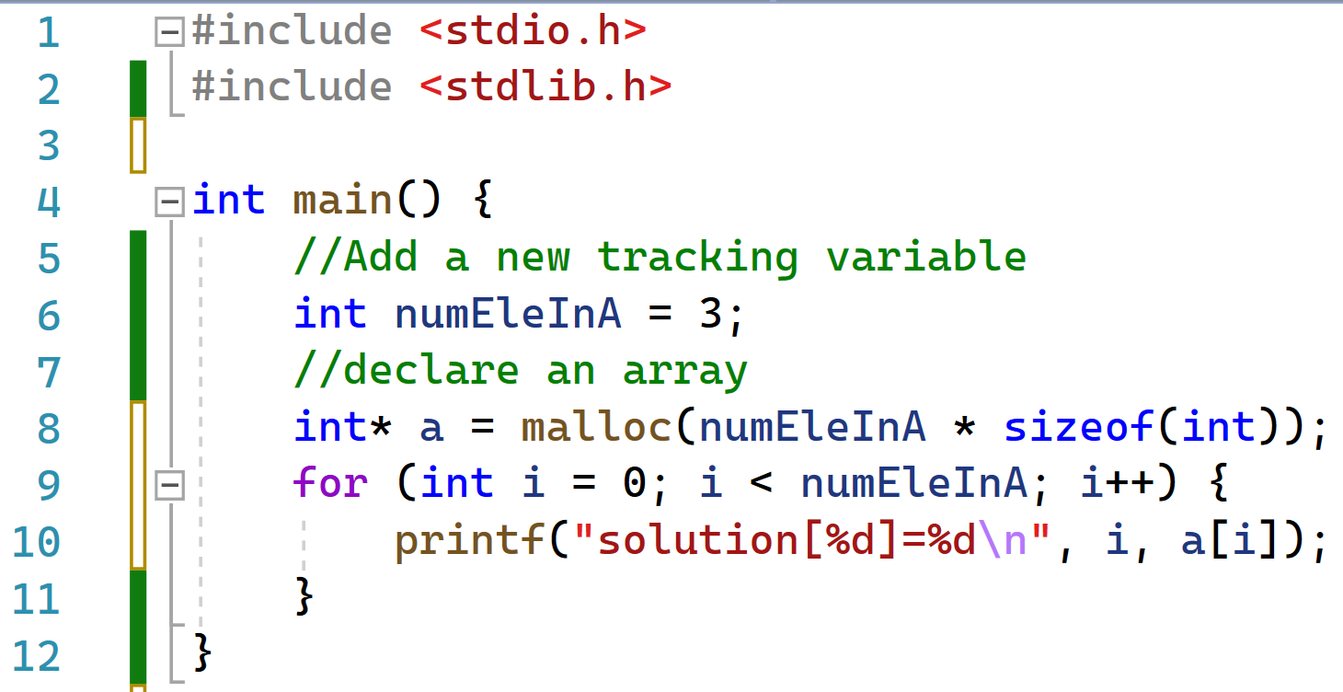
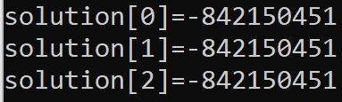

Another Question: Who lives in the empty array?

Slide 34
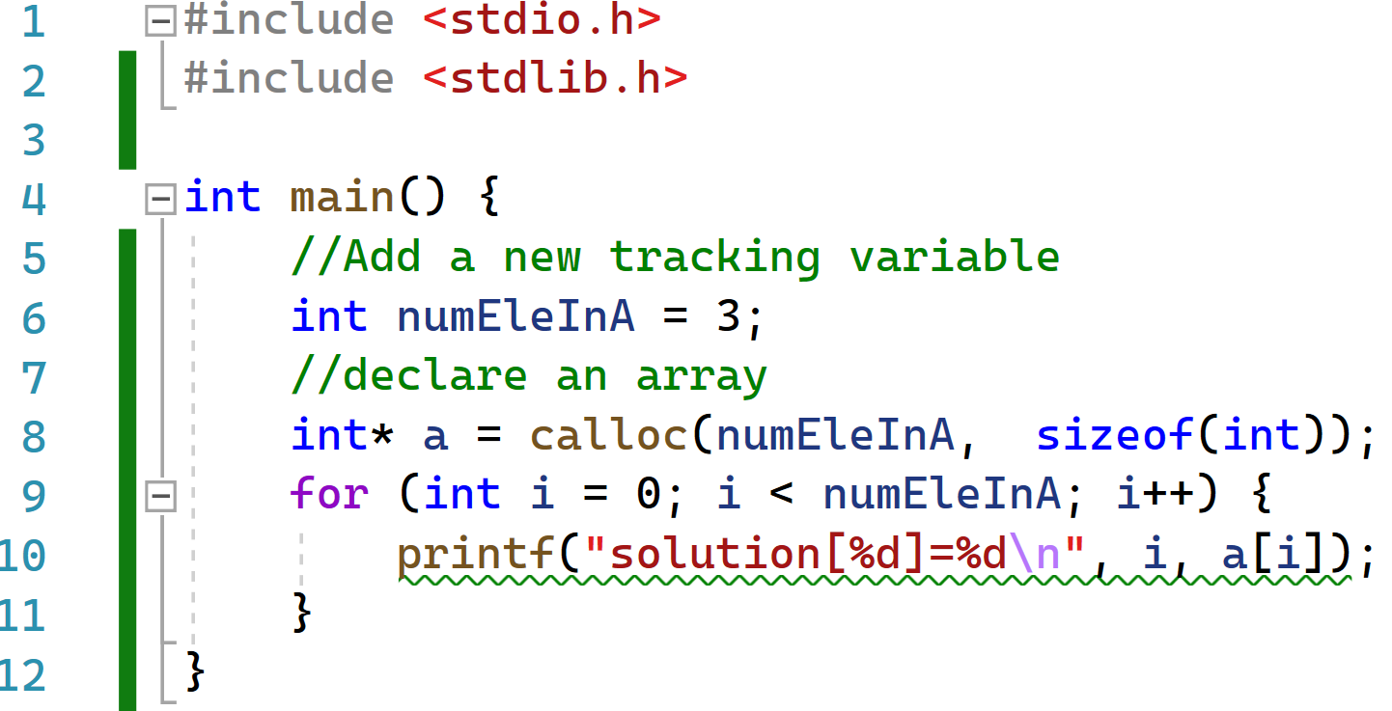
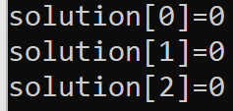
Creating arrays AND setting their values: calloc
#include <stdlib.h>
void* calloc(size_t nmemb, size_t size);
calloc() is implemented in terms of malloc()
  calloc() also initializes the content to 0

Slide 35
Adjusting array size
#include <stdlib.h>
void* realloc (void* ptr, size_t size);
What if you change your mind?
  You requested 100 bytes, but now need 200!
Before a call to realloc(p, size), p must be
  A pointer returned by a previous malloc/calloc/realloc
  Or NULL, in which case the call is equivalent to malloc(size)
char* p = malloc(100); // request 100 bytes
...
p = realloc(p, 200); // p may change!

Slide 36
Deallocation
#include <stdlib.h>
void free(void *ptr);
Straightforward
  Simply call the library function “free”
  Takes a pointer to the block to free
Do not free a pointer twice!
  After freeing a pointer, set it to NULL
free(ptr);

Slide 37
Two key rules for using memory
Rule 1: Everything you requested should be freed, eventually
Rule 2: Only free what is allocated via malloc/calloc/realloc
Consequences of not following the rules
  Memory “leaks”
    Your program will eventually run out of memory
  Undefined behavior and horrible crashes
    Freeing unallocated memory or already freed memory
      May cause a memory error and a program crash
      Worse, may corrupt the heap and cause a crash later
      Even worse, the program may keep running, totally corrupting your data, and writing it to disk without you realising

Slide 38
So far we have looked at 1D arrays with pointers…
How could we make 2D arrays with pointers? Use an array of pointers!
Value:
104
120
280
305
Here we can make a 4x3 array:
An Array of Pointers
Address in Mem:
90
91
92
93
Value:
5
6
9
2
4
5
8
9
3
8
9
3
Address in Mem:
104
105
106
120
121
122
280
281
282
305
306
307

Slide 39
Array of Pointers
3 integers, but not in an array:
3 arrays each of size 10:
  int a0;
  int a1;
  int a2;
  // array of int's
  int a[3];
  char *p0 = malloc(10);
  char *p1 = malloc(10);
  char *p2 = malloc(10);
  // array of pointers
  char * p[3];
  // Can also do with a loop
  p[0] = malloc(10);
  p[1] = malloc(10);
  p[2] = malloc(10);
One 2D array of 3x10
3 integers in an array:

Slide 40
Example: allocating 2d dynamical array
void doSomething(int m, int n)
{ int **rows;
rows = malloc(sizeof(int *) * m); // array of pointers
for (int i = 0; i < m; i++)
rows[i] = malloc(sizeof(int)*n); // one int array for each row
...
for (int i = 0; i < m; i++)
free(rows[i]);
free(rows);
}

Slide 41
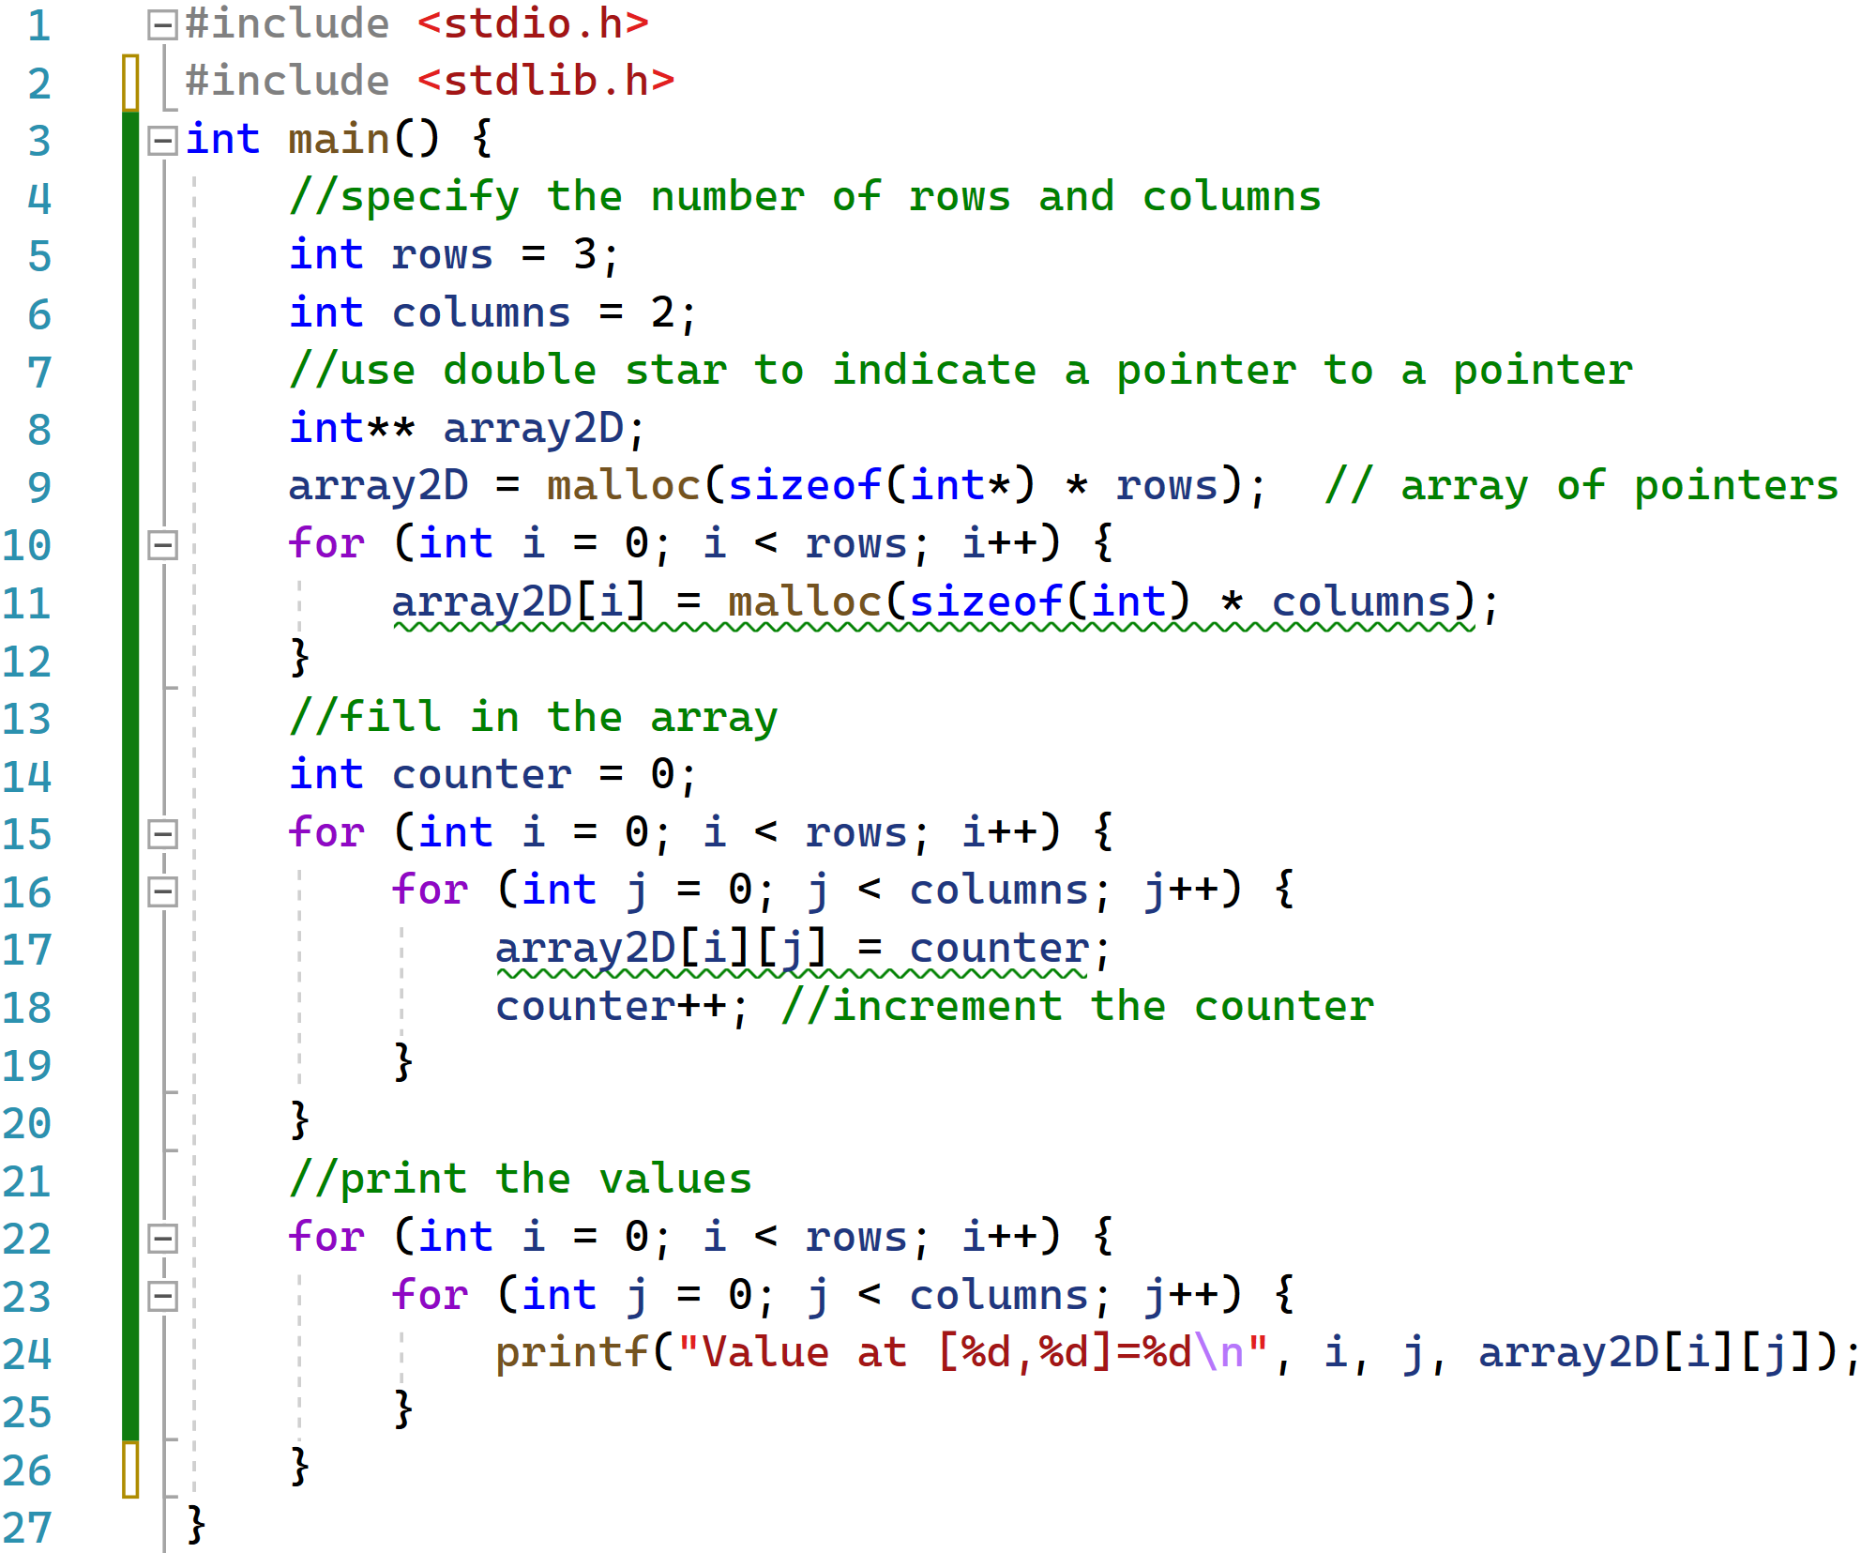
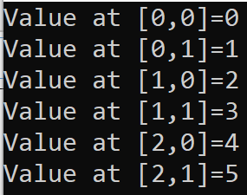

Slide 42
1. Memory Organization and Malloc
Memory Allocation Lecture Topics
2. Tracking Array Size
3. More on Arrays and Multi-dimensional Arrays

Slide 43
Conclusions 1: How to keep track of array size
How did you create the array?
Fixed size i.e.
int x[10] ;
Malloc or calloc
Are you in the method where the array was created?
Must keep track of the size yourself.
Yes? Then can use sizeof() formula we discussed.
No? Then you are working with a reference and need to keep track yourself.

Slide 44

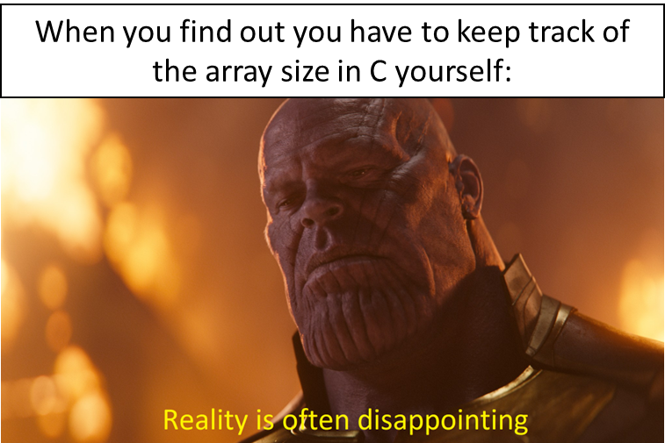
Conclusions 2
Using malloc, calloc and free are important concepts in C that you should know how to use.
You need to understand arrays are created in different sections of the memory depending on how you instantiate the array.
Two rules for memory:
Rule 1: Everything you requested should be freed, eventually
Rule 2: Only free what is allocated via malloc/calloc/realloc
We can create multi-dimensional arrays using arrays of pointers.

Slide 45
Figure Sources
https://wompampsupport.azureedge.net/fetchimage?siteId=7575&v=2&jpgQuality=100&width=700&url=https%3A%2F%2Fi.kym-cdn.com%2Fentries%2Ficons%2Ffacebook%2F000%2F031%2F197%2Fvisible.jpg
https://upload.wikimedia.org/wikipedia/commons/1/10/The_Rolling_Stones_Summerfest_in_Milwaukee_-_2015.jpg
https://ychef.files.bbci.co.uk/976x549/p03lcphh.jpg
https://www.pngitem.com/pimgs/m/11-115218_iphone-thinking-emoji-hd-png-download.png
http://www.quickmeme.com/meme/357oc1
https://www.deviantart.com/swiftwin4ds/art/Reality-is-often-disappointing-785218817
https://img.memegenerator.net/instances/84407638.jpg

